Slide 1

Unlocking Excellence
Exploring Our Capabilities
Private & Confidential

Slide 2


FlairMinds - Who we are?
A youthful company, ablaze with potential and promise.
2022
Our company's base is situated in the Cloud and…
350% YoY
(65 people strong)
The deeper you are rooted, the faster you grow.
We date, but we believe in marriages.
(average customer retention rate)
87%
We are as good as our people.
(average associate retention rate)
96.2%
Private & Confidential

Slide 3





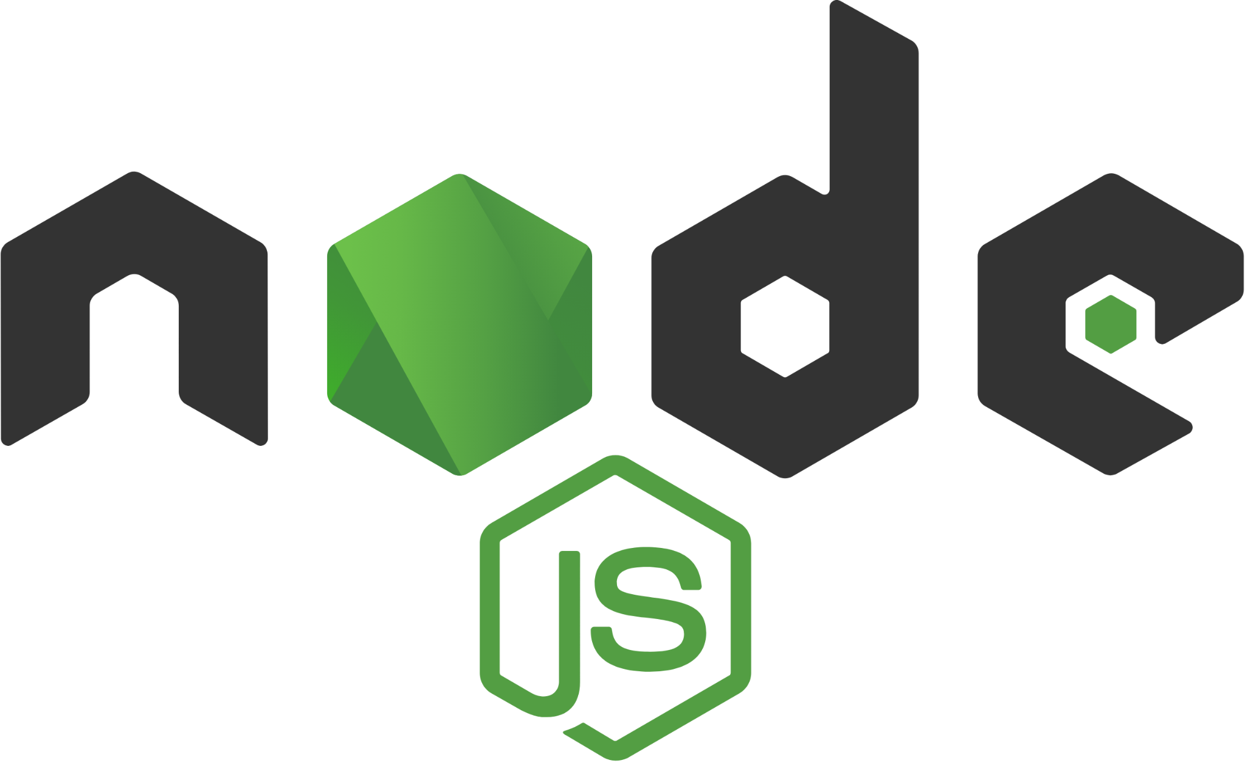
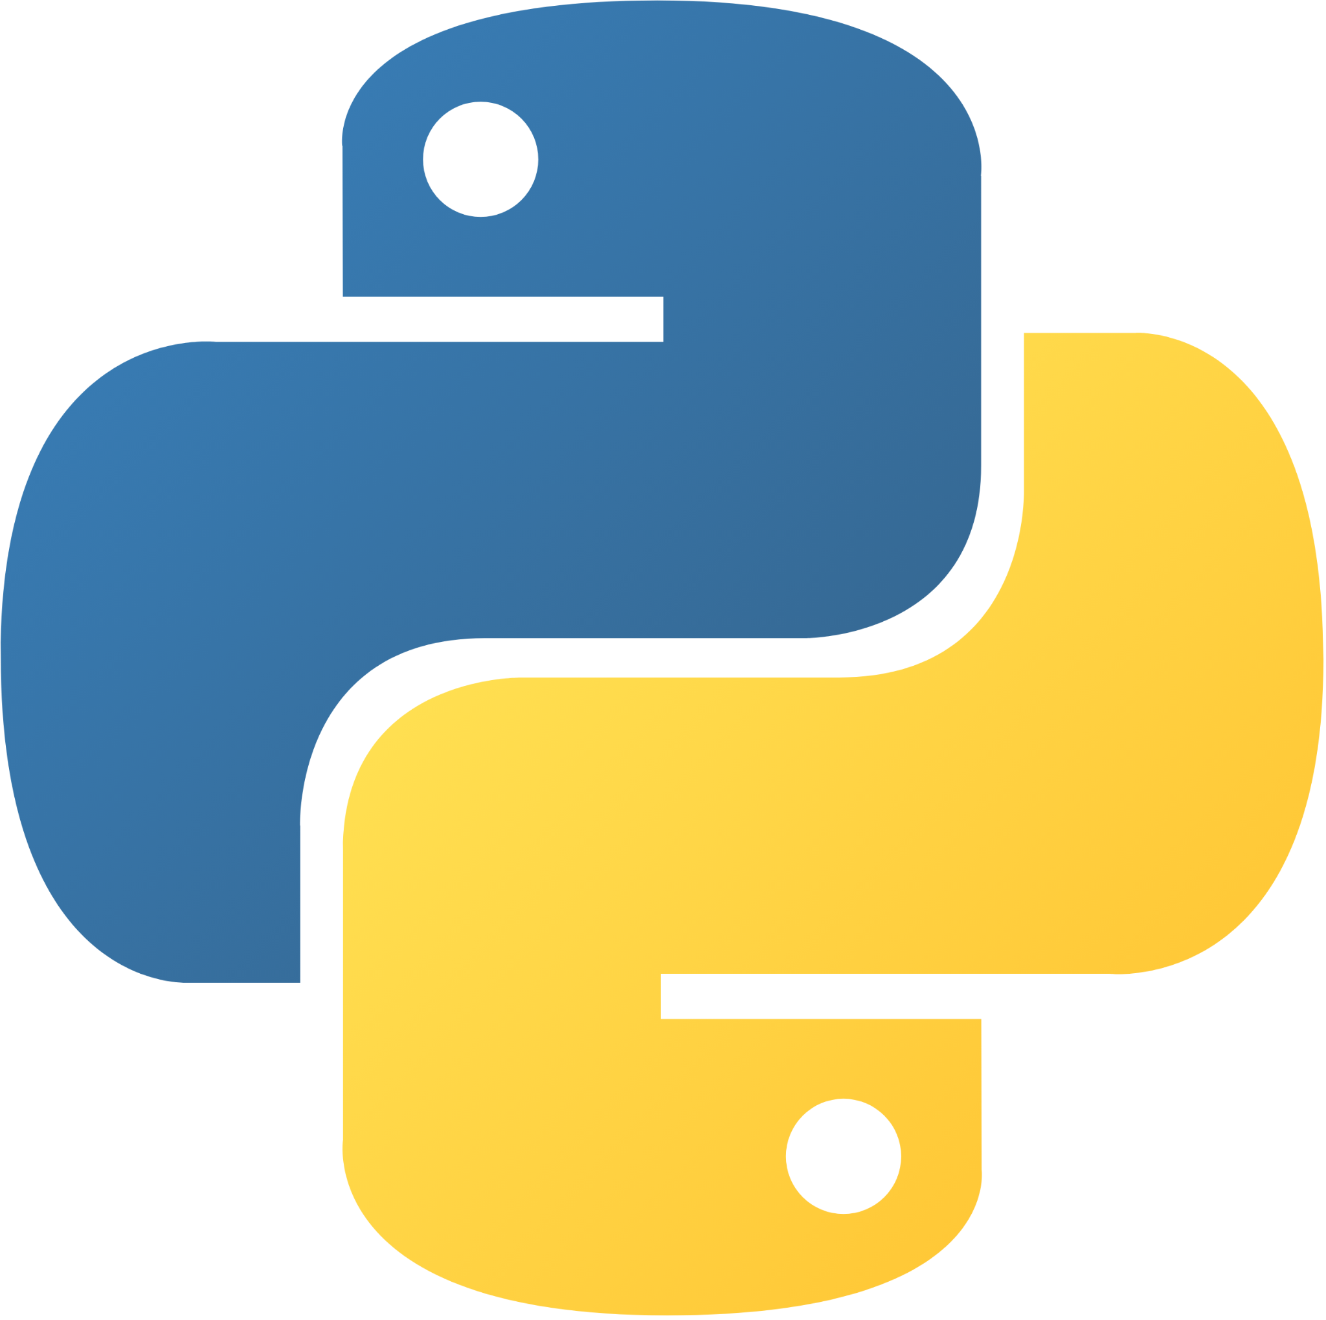



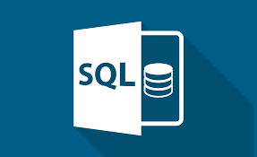



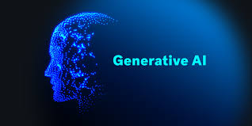
Delivery Organization
DevOps
Full Stack
Data Science
MSDB
DevOps Engineers
Full Stack Engineers
Data Engineers
Software Engineers
Security Engineers
Back End Engineers
Machine Learning Engineers
Software Test Engineers
UX Designers
Data Analysts
Software Developers
Data Scientists
Technology Architects
15+
20+
18+
Private & Confidential

Slide 4
Why FlairMinds?

Slide 5
Why FlairMinds? We help you solve these challenges
Challenges in Current Marketplace Situation
Limited Visibility into Operations
Inefficient Use of Resources
Poor Decision-Making
Missing Trends and Business Patterns
Increased Business & Compliance Risk
Siloed and Stale Data
Ability to Adapt
Competitive Disadvantage
Unoptimized Talent
Private & Confidential

Slide 6
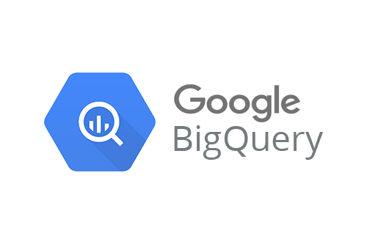
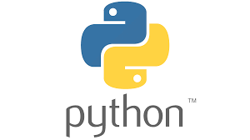


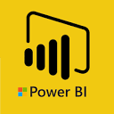

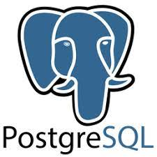



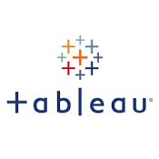









Data / Technology ecosystem at FlairMinds
STORAGE
ANALYSIS
MODEL
VISUALISE
PLATFORMS & DEVOPS
Private & Confidential

Slide 7
Technologies at FlairMinds
Methodology | Description | Tools capability @ Flairminds
Machine learning | Read hidden patterns to learn and improvise the system | Scikit_learn, ML algorithms such as - Linear regression, KNN, Random forest, SVM, XGboost etc.
Predictive analysis and visualization | Identify the likelihood of future outcomes based on historical data | ML algorithms, Azure ML. Data studio, Power BI, Tableau, Seaborn
Natural language processing | Analysis and synthesis of natural language and speech which makes human language decipherable to computer | Spacy, NLTK, Gensim, TF-IDF, Word2vec, Word2doc, Bert, FAISS
Object detection and image processing | Sorting image objects by detection, tracking and classification using computer vision | TensorFlow, Transformer, Pyspark, FAISS, OpenCV
Deep learning | A neural network that attempts to simulate human brain | PyTorch, TensorFlow, Theano, Pyspark, FAISS, OpenCV, Transformer
Big data analytics | Uncover trends, patterns and correlations in large amount of raw data | MongoDB, Azure, Google cloud, AWS, Apache spark, Tableau
Cloud services | Cloud architecture for model deployment and APIs | Azure, AWS, Google Cloud
Private & Confidential

Slide 8

People Competencies at FlairMinds
Systems Architect
Cloud Architect
Web Developer
Technology Developer
Program Management
Quality Executives
Data Scientist
Data Analyst
Data Engineer
Business Analyst
Process Analyst
Consulting Leads
Project Manager
Private & Confidential

Slide 9
Unleashing the Power of Data
How Data Science Transforms Business Functions
Customer
Distribution
Product
Pricing
Customer profiling
Customer segmentation
Acquisition Strategy
Next best action
Retention, Renewal, Lapse prediction
Customer Experience
Performance
Supplier analytics and Segmentation
Sales Lead
Pipeline Forecasting
Producer Retention
Web Journey / Omnichannel Effectiveness
Channel Optimization
New Product Development
Portfolio Management
Underwriting Risk Selection
Product Analysis
Loss Control
Optimizing Underwriting Cycle
Automated Rules Engine
Market and Competitive Research
Exposure / Policy level Pricing
Segmentation
Real Time Price Optimization
Pricing Elasticity
Competitive Pricing
Private & Confidential

Slide 10



Approach at FlairMinds
The data science projects are agile by definition and follow an iterative workflow. It is necessary to perform multiple iterations before arriving at a final working model for industrialization.
>
Creation of variable
Preliminary analysis
Model selection
Comparison of algorithms
Business integration
Data
Preparation
Modelisation
Data Visualization
Business integration
>
>
Business integration
CSV
ETL and
pre-processing
Evaluation
Industrialisation
Excel
Extract Transform and Load the different data sources
Determine the schema and data structure
Business integration
DB with results
Analysis of the existent
Evaluate the data quality
>
Performance measurement
generalisation
Recette standard
Business Insights
Performance monitoring
SQL
Preparation
Model
Industrialization
Private & Confidential

Slide 11









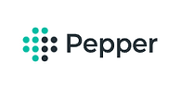




Our Valued Customers
Private & Confidential

Slide 12
Case studies

Slide 13



Asset Tech Financial Consultant
Data Science
Objective: Analysis of the portfolios and build a leverage model
Outcome: Automated portfolio analysis for portfolios and credit management for leverage modelling
Data Sources
Data Processing
Visualization
Assets data
Data analysis
Data model
Results
Execution flow based on dependencies
Creation of base data
Relationships and dependencies between the Data
Processing and computing of new features based on the relationship with the base data
Interactive web app to manipulate the data analysis process
Summarized results after complete analysis
Interactive user access to choose the service
Freedom to run multiple simulations for different scenarios
Plotly dash
Portfolio data
Credit data
Data analysis
Private & Confidential

Slide 14
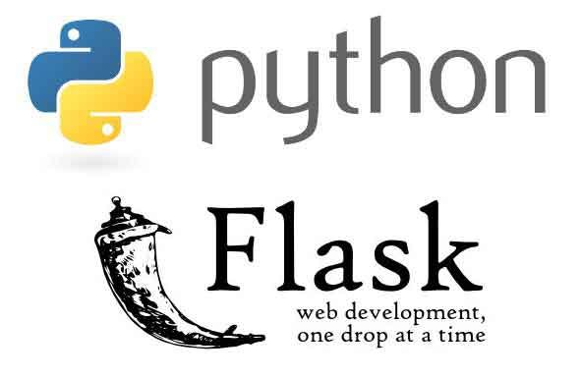

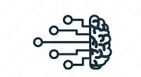
Carbon Emission Scoring Engine
Data Science
Objective: To develop a system which will be able to calculate carbon footprint of company or organization.
Outcome: A system which provide any company or organization to calculate carbon footprint based on emission activities.
Data Processing
Visualization
Data Sources
Exploration
Development
Deployment
Collected data from multiple data sources and created a master table.
●Exploration of the existing components of the solution
●Tested and deployed the existing solution
●Defined a product development roadmap.
● Created scripts for ingestion of data from different websites.
●Created APIs in flask for frontend team to access and implement into the user interface.
● Implemented NLP solutions for mapping of emission activities.
●Containerized the solution using Docker.
●Deployed the solution on a cloud environment.
●Tested with frontend team.
Private & Confidential

Slide 15
DevOps
Retail IT Software company
Objective
Create a microservices architecture SaaS product on AWS cloud. FM has been engaged to create the overall cloud architecture.
Solution
Cloud architecture that is fully automated, cross-region scalable , adaptable and highly secure; built with IaC (Infrastructure as Code) along with drift detection to stop infrastructure tampering.​
Benefits
Scalable and secure infrastructure. Fully automated infrastructure for easy deployment and updates
Private & Confidential

Slide 16
SecOps/Full Stack
Flight Prediction And Rebooking Application
Objective
Efficiently manage schedules, tackle flight issues with rebooking suggestions, enhance user experience in dynamic travel.
Create app for real-time flight updates, prioritize delays, offer rebooking, simplify ticket management, enhance travel.
Solution
Developed React Native mobile app, Next JS web app with flight prediction, integrated ticketing, search for seamless experience.
Removed unused resources, optimized services, integrated EKS, and implemented auto scaling for efficient infrastructure management.
Business Benefits
Instantly check flight status, rebook during disruptions, addressing delays and cancellations, improving travel convenience.
54% reduction in cost while 24% increase in deployed services
Private & Confidential

Slide 17
Full Stack
Digital Loan Operations Optimization Project
Objective
Digitizing lending operations, reduce manual work, errors, expedite loan approvals, foster collaboration with partners, expand product offerings, enhance competitiveness.
Solution
Utilizing Java for robust backend development, MySQL for efficient data management, and React for dynamic frontend interfaces.
Adopted a microservices architecture, the bank and consumer applications. Developed separate services, ensuring modularity, scalability, and maintainability throughout the lending product's lifecycle.
Business Benefits
Automated workflows boosting efficiency, accelerate loan processing, cut costs. Streamlined applications, faster approvals, and adaptability enhance customer experience and scalability.
Private & Confidential

Slide 18
MSDB
Ladder Logic Project Creation Software
Objective
Develop a comprehensive Ladder programming platform for efficient industrial automation.
Solution
Our software enabled users to visually design logic using ladder diagrams, seamlessly translate it into native code compatible with hardware firmware. Display PLC address values intuitively for user-friendly logic creation.
Business Benefits
Reduced reliance on external software, decreases customer expenses, thereby lowering the overall cost of the final product.
Private & Confidential

Slide 19
MSDB
Learning & Development Marketplace Portal
Objective
Developing an integrated training management software solution to efficiently support L&D leaders and HR teams in delivering comprehensive training resources and expertise to organizations of all sizes.
Solution
A comprehensive training management app leveraging MS SQL, Win Azure, C#, and React for seamless delivery and scalability.
Business Benefits
Streamlined training processes and expanded expertise through our comprehensive software solution for organizational development.
Private & Confidential

Slide 20
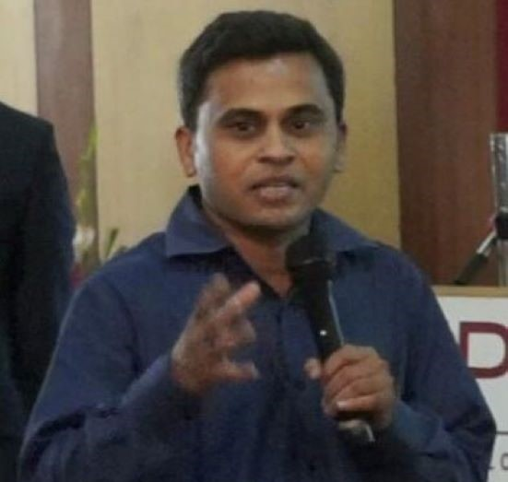






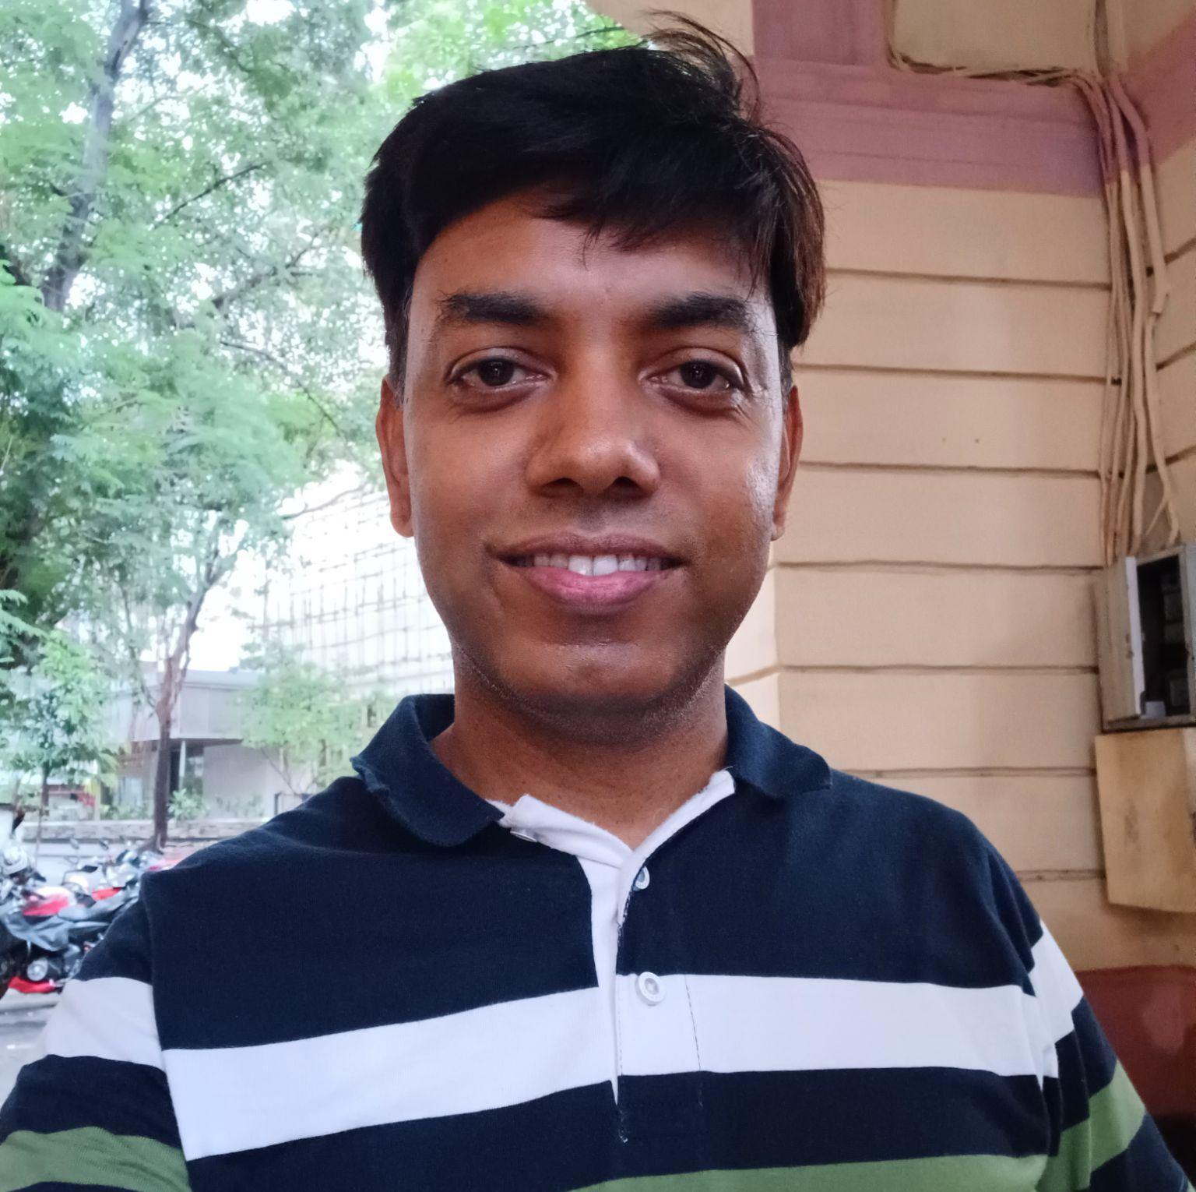


Driving our Engagement Success - Leadership
Hasmukh Parekh
Business Development & Strategy
Sameer Awate
Technology Architect- Microsoft and Databases
Parag Khandekar
Service Delivery and Operations
Gaurav Kohli
Technical Architect and DevOps
Krishna Bhavsar
Data Science Architecture & Projects
Awanish Golwara
Technology Solutions and Development
Yogesh Amritkar
Technical Advisor (Microsoft)
Punit Suman
Technology Solutions
(Full Stack)
Private & Confidential

Slide 21
Private & Confidential

